Slide 1


HTML Advanced + CSS Basics
By Lalita Joshi

Slide 2
Recap of Day 1
HTML Structure
Heading, Paragraphs, Links, Images, Lists, Tables, Basic Tags.
Basic Registration Form (HTML only)

Slide 3

Semantic Tags
Semantic tags are HTML tags with a meaning.
They describe the purpose of the content inside them.
Make webpages easier to read & understand.

Slide 4
Why Use Semantic Tags?
Improves code readability for developers.
Helps search engines understand content.
Supports screen readers for accessibility.
Provides a clear structure to webpages.

Slide 5
Examples of Semantic Tags
<header> → Top section of a page/section.
<nav> → Navigation links/menu.
<main> → Main content of the page.
<section> → Thematic group of content.
<article> → Independent content block (blog, post).
<aside> → Side content (ads, sidebar).
<footer> → Bottom section of a page.
<figure> → Groups media content.
<figcaption> → Caption for figure/media.

Slide 6

Semantic Tags Structure

Slide 7

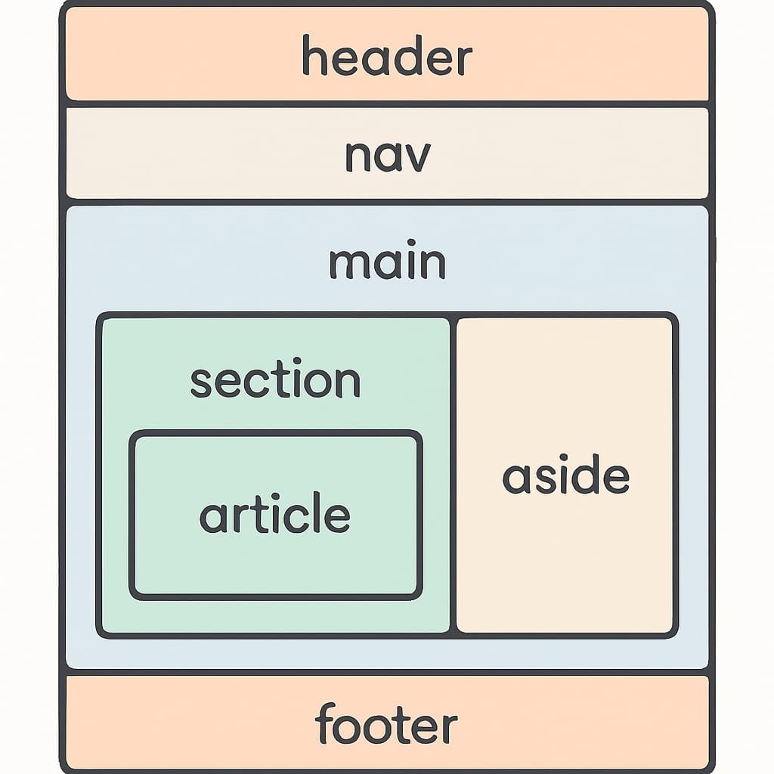
Semantic Tags Webpage Structure

Slide 8
Example of Semantic Tags
<header>
<h1>My Website</h1>
<p>Welcome to my webpage</p>
</header>
<nav>
<a href="#">Home</a>
<a href="#">About</a>
<a href="#">Contact</a></nav>
<main>
<section><h2>About Us</h2>
<p>This is the about section of the website.</p> </section>
<article>
<h2>Latest Article</h2>
<p>This is an independent piece of content.</p> </article>
<aside>
<h3>Sidebar</h3> <p>Related links and ads go here.</p></aside>
</main>
<footer> <p>© 2025 My Website. All rights reserved.</p> </footer>

Slide 9
Multimedia in HTML
Add video, audio, and external pages.
<audio controls> <source src="song.mp3" type="audio/mpeg"></audio>
<video width="320" height="240" controls> <source src="movie.mp4" type="video/mp4"></video>
<iframe src="https://www.google.com"></iframe>

Slide 10
Introduction to CSS

Slide 11
Introduction to CSS
CSS = Cascading Style Sheets
Used for styling HTML pages
Three types:
Inline CSS → inside tag
Internal CSS → inside <style> in <head>
External CSS → in separate file (.css) extention.

Slide 12
1. Inline CSS
Inline CSS means writing CSS directly inside the HTML tag using the Style attribute.
HTML FILE :
<p style="color:blue; font-size:20px;">
This is blue text with inline CSS.</p>

Slide 13
2 Internal CSS
Internal CSS means writing CSS inside the <style> tag within the <head> section of an HTML document.
HTML FILE :
<head>
<style>
body { background-color: lightyellow; }
h1 { color: red; }
</style>
</head>

Slide 14
3 External CSS Example
External CSS means writing all your CSS code in a separatee .css file and linking it to your HTML file using the <link>Tag inside the <head> section.
Create style.css:
body
{
font-family: Arial;
background-color: lightblue;
}
2. Link in HTML File
<link rel="stylesheet" href="style.css">

Slide 15
CSS Selectors
ID Selector: #idName { }
Class Selector: .className { }
Group Selector: h1, p { }
Universal Selector: * { }

Slide 16
Id Selector
Think of ID like Aadhaar Card — unique for each person.
Used to select ONE specific element.
Represented with a # (hash) symbol in CSS.

Slide 17
Id Selector example
HTML FILE :
<p id="special">This is special!</p>
CSS FILE :
#special
{
color: red;
font-weight: bold;
}

Slide 18
Class Selector
Think of Class like a school uniform — many students can wear the same uniform.
Used for grouping elements.
Represented with a . (dot) symbol in CSS.

Slide 19
Class Selector example
HTML FILE :
<p class="highlight">Hello</p>
<p class="highlight">World</p>
CSS FILE :
.highlight {
color: blue;
font-size: 20px;
}

Slide 20
Group Selector
A Group Selector lets you apply the same style to multiple elements at once without repeating code.
It helps in reducing code repetition and keeps the stylesheet clean and organized

Slide 21
Group Selector example
HTML FILE :
<h1>Welcome</h1>
<h2>Subheading</h2>
<p>This is a paragraph.</p>
CSS FILE :
h1, h2, p
{
text-align: center;
color: teal;
}

Slide 22
Universal Selector
Universal Selector in CSS is used to select all elements on a webpage
and apply the same style to them.
It is represented by an asterisk (* symbol).

Slide 23
Universal Selector example
HTML FILE :
<h1>Hello World</h1>
<p>This is a paragraph.</p>
<button>Click Me</button>
CSS FILE :
* {
color: red;
font-family: Arial;
}

Slide 24
Fonts & Colors
HTML FILE :
<h1>Hello Everyone</h1>
<p>This is a simple paragraph.</p>
<p>All text has the same font and color!</p>
CSS FILE :
* {
font-family: Arial, sans-serif;
color: darkgreen;
}

Slide 25
Text Styling
HTML FILE :
<h1>Welcome</h1>
<p>This is a styled paragraph.</p>
<p>Text styling makes pages look better!</p>
CSS FILE :
h1 {
color: darkblue;
text-align: center;
text-transform: uppercase;
}
p {
color: brown;
font-size: 18px;
font-style: italic;
text-align: justify;
}

Slide 26
Day 2 Activity
Apply CSS to the same Registration Form.
Change the background color of the page.
Change the font style & color.
Style the Submit button.
Make sure to use inline, internal and external CSS to create separate web pages of Registration form.
Use selectors in external CSS.

Slide 27
Summary
Learned Semantic tags & Multimedia in HTML
Learned CSS (Inline, Internal, External)
Used selectors, fonts, colors, text styling
Styled Registration Form with CSS

Slide 28
Thank you
ANY QESTIONS ?

